Slide 1

林瑞盛
E-mail: rslin@hcu.edu.tw

Slide 2

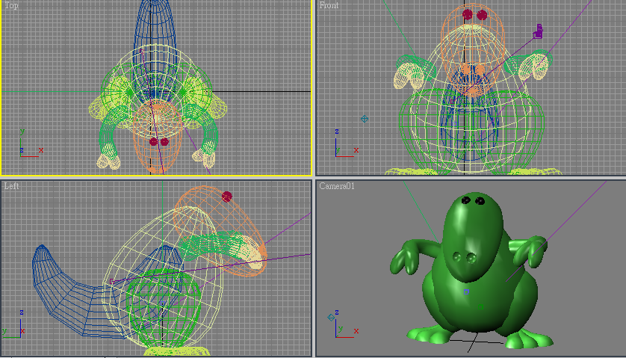
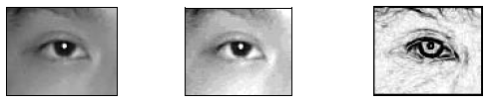
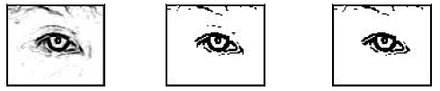
主要介紹三維繪圖(3D Graphics)
利用電腦將虛擬的實境顯示於營幕
也可將虛擬的物體合成於真實世界當中
與電腦視覺有所不同

Slide 3

Edward Angel, Interactive Computer Graphics, A Top-down Approach with OpenGL (Fifth Edition), Addison-Wesley

Slide 4

Mid Exam. (期中): 30%
Final Exam. (期末): 30%
Attendance (出席率): 20%
Homework (作業): 10%
Quiz (小考): 10%

Slide 5

廣泛介紹電腦繪圖知識
  Software (軟體)
  Hardware (硬體)
  Applications (應用)
建立正確的電腦繪圖概念
使用Visual C++ 呼叫 OpenGL 來撰寫

Slide 6

Programming skills in C (or C++)
Basic Data Structures (基本資料結構)
  Linked lists (串列)
  Arrays (陣列)
Geometry (幾合學)
Simple Linear Algebra (線性代數)

Slide 7

Can run OpenGL on any system
  Windows
  Linux
  Mac
Get GLUT from web if needed

Slide 8

Other helpful references
  OpenGL: A Primer, Edward Angel, Addison-Wesley, (Third Edition), 2008
    Designed for students who need more programming information
  The OpenGL Programmer’s Guide (the Redbook) and the OpenGL Reference Manual (The Blue book), Addison-Wesley,

Slide 9

www.opengl.org
www.cs.unm.edu/~angel
xoax.net/comp/cpp/opengl/Lesson1.php#supporttext
www.opengl.org/resources/code/samples/glut_examples/examples/examples.html

Slide 10

Part 1: Introduction
Text: Chapter 1
Lectures
  What is Computer Graphics?
  Applications Areas
  History
  Image formation
  Basic Architecture

Slide 11

Part 2: Basic OpenGL
Text: Chapters 2-3
Lectures
  Architecture
  GLUT
  Simple programs in two and three dimensions
  Interaction

Slide 12

Part 3: Three-Dimensional Graphics
Text: Chapters 4-6
Lectures
  Geometry
  Transformations
  Homogeneous Coordinates
  Viewing
  Shading

Slide 13

Part 5: Implementation
Text: Chapter 7
Lectures:
  Approaches (object vs image space)
  Implementing the pipeline
  Clipping
  Line drawing
  Polygon Fill
  Display issues (color)

Slide 14

Part 4: Discrete Methods
Text: Chapter 8
Lectures
  Buffers
  Bitmaps and Pixel Maps
  Texture Mapping
  Compositing and Transparency

Slide 15

Model(建模):真實世界裡的任何事物都可以在電腦中用簡單的點、線、多邊形表示出來。
OpenGL函式庫除提供簡單的點、線、多邊形的繪製函數外，也提供3D物件 (如:球體、角錐、管狀體等)和複雜的曲線和曲面(如:Bezier和Nurbs等)的繪製函數。
反鋸齒(Anti-aliasing)
輻射光(Emitted Light)、環境光(Ambient Light)、散射光(Diffuse Light)、鏡面光(Specular Light)

Slide 16
場景(Scene)
融合(Fusion)
霧化(Fog)
紋理(Texture)
雙緩存(Double Buffering):前台緩存與後台緩存。
動畫(Animation)
陰影(Shader)
繪製(Render)
彩現(Rasterization)

Slide 17

電腦繪圖簡介
開發環境設定
影像成像系統
OpenGL 概觀
輸入與互動控制
幾合學轉換
視角與視界
光、陰影、塗色彩現

